Slide 1
QUALITY ASSURANCE (QA) ASSESSMENT
Prepared by:
Farihah Fasya binti Mohd Najib
Prepared for:
AEM Energy Solutions Sdn. Bhd. (‘AEM Enersol’)

Slide 2
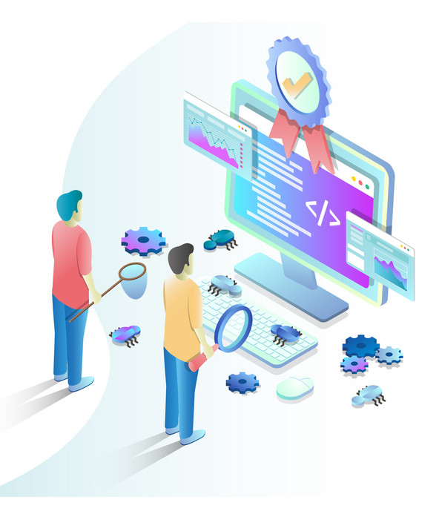
TECHNICAL ASSESSMENT
Prepare a slide presentation:
Explain how do you understand on the QA role in software development
How they can assist in improving the software testing
Writing test case and test plan
Understand on QA Testing Life Cycle
Ultimately to be one of the important roles in the organization.

Slide 3

QA Role in Software Development
Test Planning
Reporting Bugs or Issue
Provide the objective of testing that need to be achieve at the end of the test, verified scenario that need to be test, estimated time for testing. In short, get the requirement before start test.
Communicate with software developer if faced with the bugs or issue during the test.
Planning or Design Test Cases
Prepare the Test Result
Create the test case where include the list of potential issue. For example, if put wrong value on the text field, is it correct alert will display.
During the testing need to prepare the test result that include the information use for test, screenshot of the test, expected result and status of the testing.
Communicate with Project Manager, Development Team and Clients (If needed)
Execute Test
QA need to run testing using the appropriate method of testing such as manually testing or automation testing (using testing tools).
Update or discuss on the test progress to the project manager and development team. Communicate with clients if there have some issue faced or to pass the acceptance form to them

Slide 4
How They Assist in Improving the Software Testing
QA need to understand well what are they going to test (about the system) and plan the time for testing very well in order to avoid delay for production.
If software testing is successful, it can reduce the risk of error or bugs after the production or deployment.
SOFTWARE TESTING

Slide 5
Test Case
Test Description | Enhancement on login screen and added new field (Last Name) on Sign Up screen.
Tester Name | QA – Farihah
Completion Date | 29/09/2022
2022
No | Module/ Screen | Scenario | Test Details | Expected Result | Date Test | Status
1 | Login | [Exceptional] Login using wrong User ID and Password | Enter User ID: abc123 Enter Password: 123 Click Login | Cannot assess to the system. Alert “Please enter the correct User ID or Password” displayed successfully. | 27/09/2022 | Passed
2 | Login | [Exceptional] Login using special character on User ID | Enter User ID: @@@ Enter Password: 123 Click Login | Cannot assess to the system. Alert “Special character cannot use on User ID” displayed successfully. | 27/09/2022 | Passed

Slide 6
TEST PLAN FOR ABC SYSTEM
APPROVAL
Approved By: | Signature: | Date:
2015
INTRODUCTION
2022
ABC System is a registered system that developed for Megah Holding Sdn Bhd which store their clients information.
Test Plan
OBJECTIVE
All screen can function successfully
User record is synchronized with table UT0120.
CHANGE HISTORY
Version | Author | Reviewed By | Approve By | Comments | Approve Date
1.0 | Ali | Farihah | Manager Name | Version 1.0 has developed | 27/09/2022
**Can added other section like cost, schedule, etc.

Slide 7
QA Testing Life Cycle
Requirement Analysis
Test Environment Setup
1
On this phase, QA need to collect the requirement of the testing in detail from discussion with development team or project manager.
4
QA need to prepare the hardware or tools that need to use for testing.
6
1
Test Closure
Requirement Analysis
Test Planning
Test Execution
QA Testing Life Cycle
On this phase, QA usually will run the test based on the test plan and test case created before. This phase also will include bug or error reporting to development team.
5
2
2
QA need to determine the test plan which include the test environment, test limitation, testing objective and test schedule.
5
Test Execution
Test Planning
3
3
Test Case Development
Test Closure
Test Environment Setup
Test Case Development
3
This phase require QA to create the test cases (include all potential scenario) and test script (if use automation tools).
6
Last phase will include the completion of test result reporting, acceptance form (if needed) and ensure that objective has achieve.

Slide 8
Ultimately To Be One Of The Important Roles In The Organization.
Quality Assurance Role can help organization to satisfy the clients based on requirement, expectations, and standards that requested by clients. Indirectly, organization will gained trust and loyalty from their clients based on best quality of service or products offered.
Quality Assurance Role also important to an organization in order to avoid system failure, error or bugs before handing over the system to the client for their use.

Slide 9
THANK YOU

